Slide 1
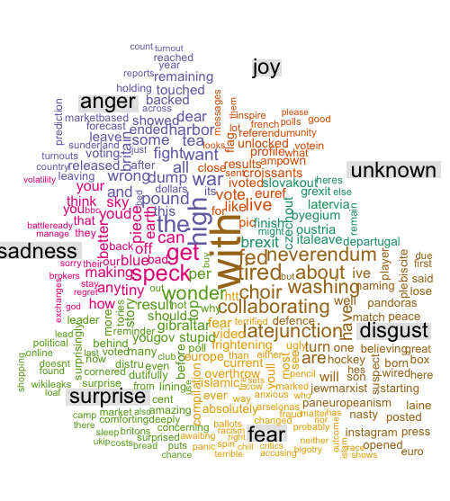
Visualizing Emotion Flow of a Video by Classifying Subtitles
By-
Tejas Dharamsi
Siddharth Varia
Nitesh Surtani
Keerti Agrawal

Slide 2
Introduction
GOAL: Automatically predict the emotion flow in videos using textual features.
IDEA: Subtitles are parallelly aligned to the scenes. Use the subtitle text to predict the emotion of a scene.
APPROACH: Develop an automatic classification model for identifying emotions in each scene.

Slide 3
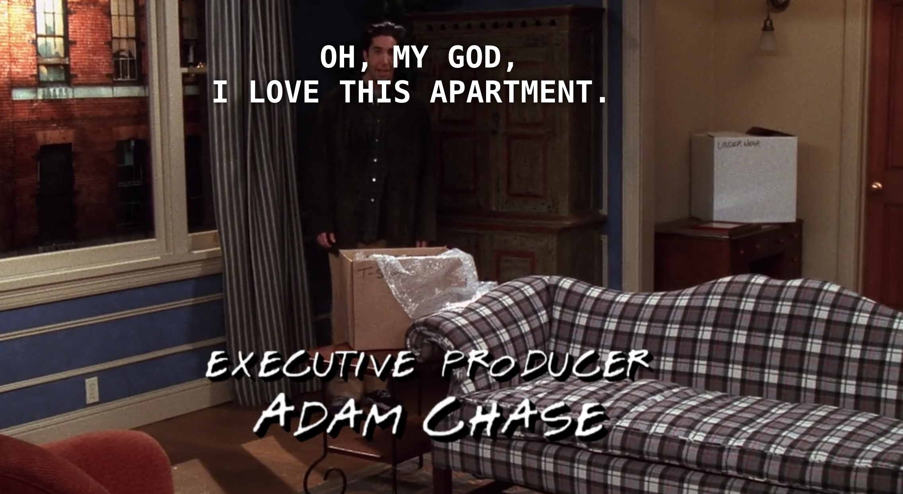
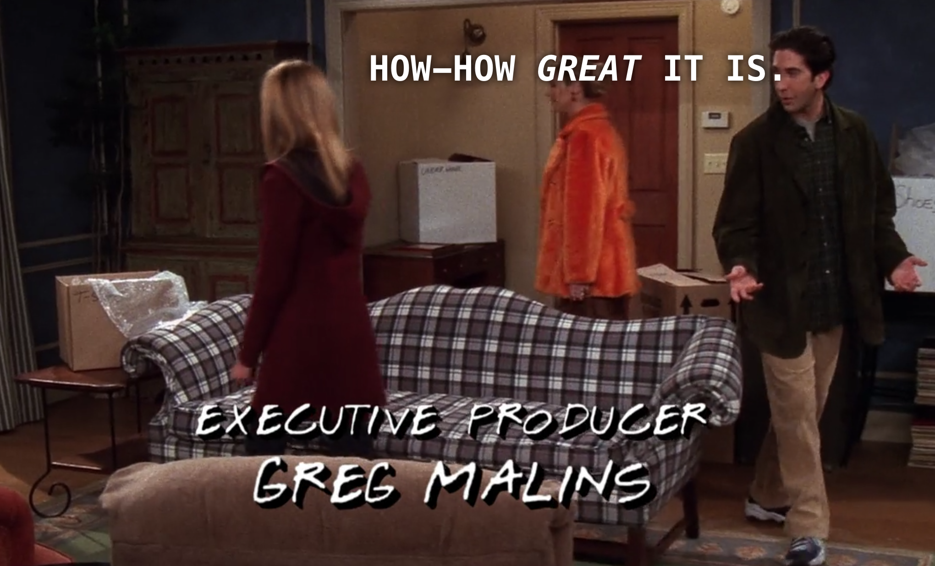
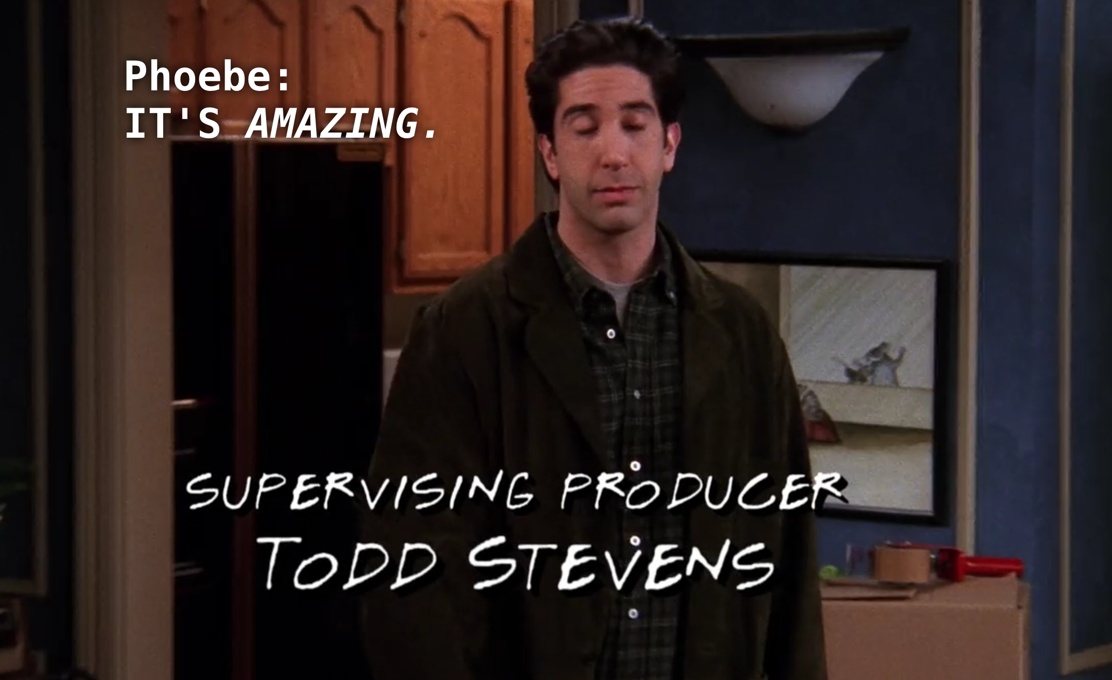
Approach Explained - Friends Video Clips
Oh, My God, I Love This Apartment
How Great It Is
It’s Amazing

Slide 4
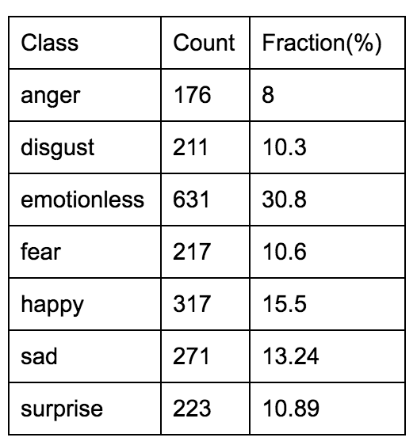
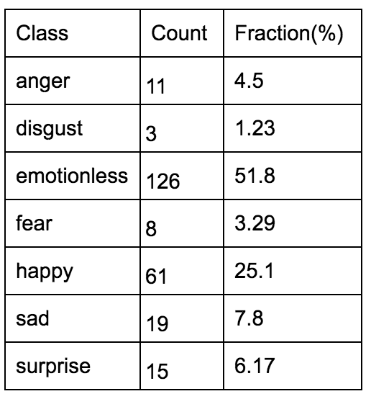
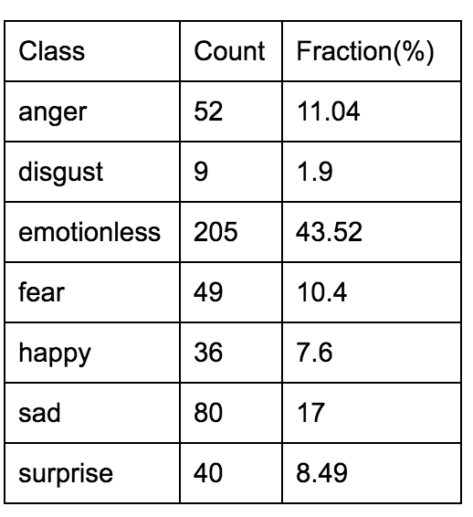
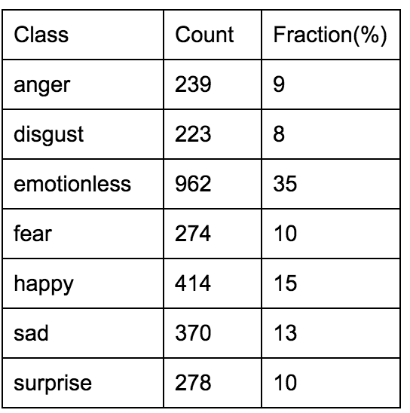
Dataset
Video Subtitles and Emotional Labels from [Utsav et al, 2015] paper
Emotions tagged from 3 subtitle files: Titanic, Friends, Walking Dead
Titanic (2046 Sentences) Friends (243 Sentences) Walking Dead (471 Sentences) Overall

Slide 5
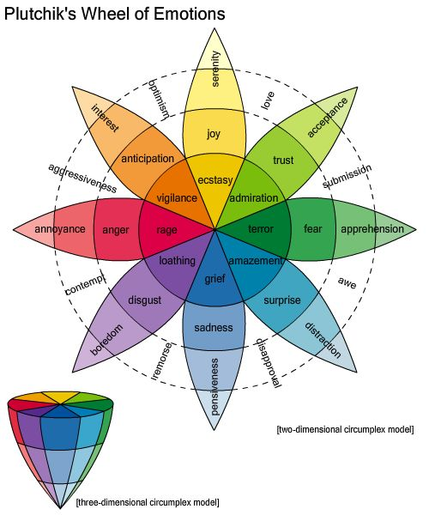
Lexicon
Emolex
14,182 words with ~25,000 word senses markings
Issues: Low Coverage: ~30%.
Solution: Combine other lexicons
WN Affect

Slide 6
Models
SVM
Used L2 regularization with ‘Linear’ and ‘RBF’ kernels
Results better with ‘Linear’ compared to ‘RBF’ kernel
Logistic Regression
Used L2 regularization with liblinear solver and OVR scheme to handle multiple classes.
Random Forest
Number of trees equal to 10, Used ‘Gini’ impurity as split criteria
All results are produced using K-Fold cross validation with K=5

Slide 7
Feature Selection
Unigrams
Bigrams
POS-Percent (JJ, NN, RB, VB)
Last k-tags (Time Series)
Punctuations
Cumulative Emotion in Sentence

Slide 8
Pre-Processing
To extract the features, we perform pre-processing of text:
Tokenize the text
POS tag: use Nouns (NN), Verbs (VB), Adjective (JJ), Adverbs (RB)
Lemmatize the words :: Use only the root word to reduce the morphological variants.

Slide 9
Results
Combined Data Set - LR
Class | Precision | Recall | F-score
emotionless | 0.71 | .73 | .72
happy | .75 | .75 | .75
sad | .70 | .71 | .70
surprise | .56 | .55 | .55
fear | .76 | .78 | .77
disgust | .58 | .51 | .54
anger | .62 | .62 | .62

Slide 10
Comparison of Classification Models
Class | F-score (SVM) | F-score (RF) | F-score(LR)
emotionless | 0.72 | .69 | .72
happy | .75 | .72 | .75
sad | .70 | .67 | .70
surprise | .54 | .49 | .55
fear | .77 | .71 | .77
disgust | .55 | .48 | .54
anger | .62 | .54 | .62

Slide 11
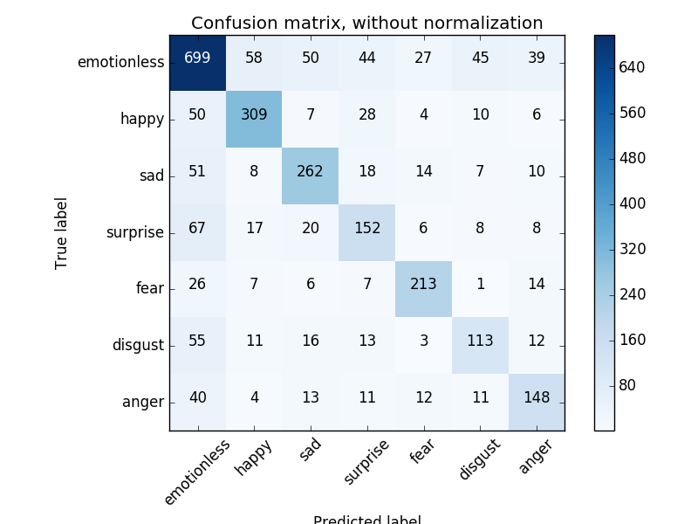
Confusion Matrix
For Combined Dataset

Slide 12
Feature Additive Study
Added Features | Accuracy
unigram+bigram | 35%
+punc_features | 37%
+POS_features | 38%
+prev_label3 | 47%
+prev_label2 | 55%
+prev_label1 | 69%

Slide 13
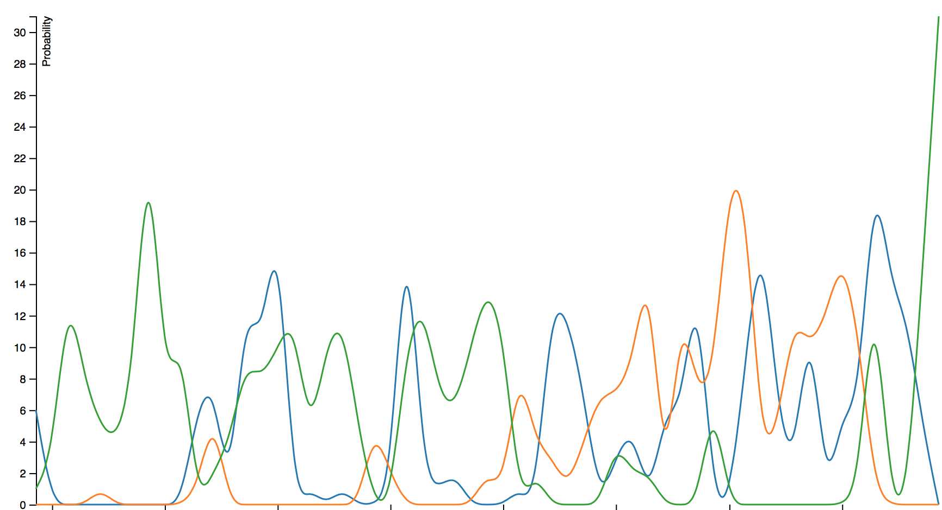
Visualization - Titanic Emotions Flow
Final Song of the Movie
Happy
Frequency
Rise in Fear
Fear
Sad
Movie Timeline

Slide 14
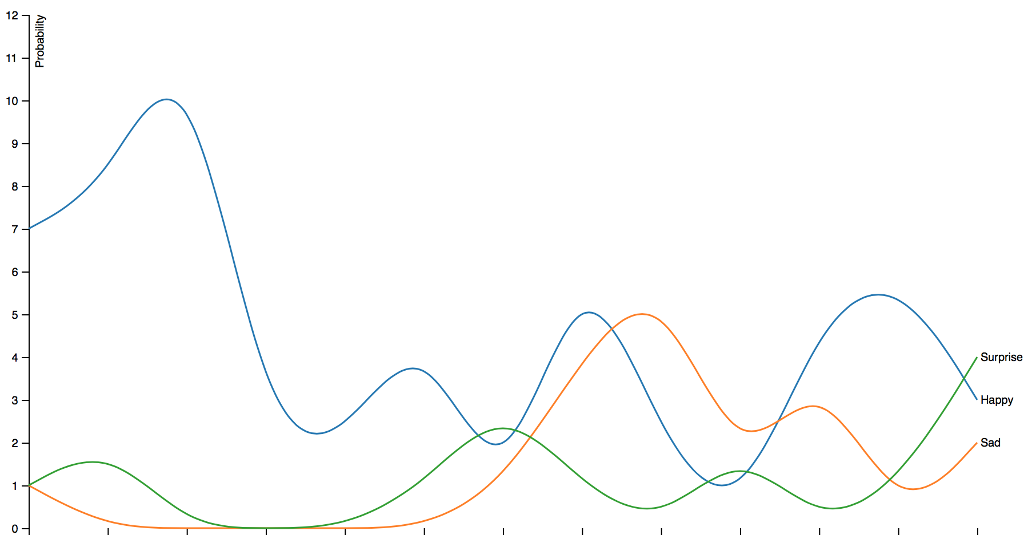
Visualization - Friends Emotions Flow
Effect of Song
Frequency
Movie Timeline

Slide 15
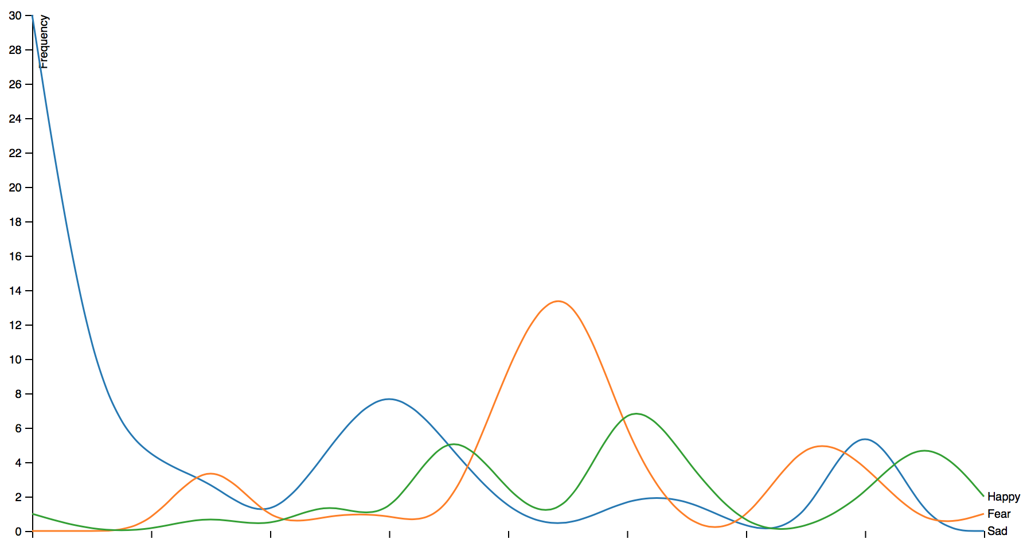
Visualization- Walking Dead Emotions Flow
Rise in Fear
Movie Timeline

Slide 16

Interactive Emotions Word Cloud - Titanic

Slide 17
Thank You

